Slide 1
Diagnostic Analysis

Slide 2
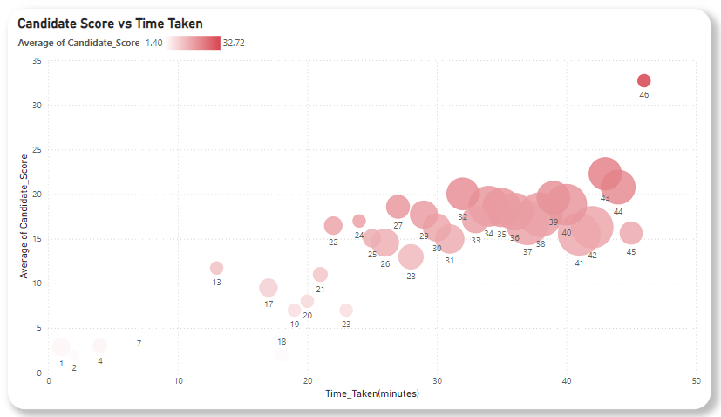
Performance vs. Time Taken

Slide 3
Performance vs. Time Taken
Main goal is to check if:
Did candidates scoring lower take more time?
Are faster test-takers performing better?
Conclusion:
Based on analysis, we can candidates are utilizing optimum of time allocated, the most of average performing candidates utilizing average time allocated.
Hence there is nothing been seen that time matters on performance.

Slide 4
Difficulty Level vs. Scores:
Are candidates scoring low in specific sections/tests?
Identify patterns of difficult tests.

Slide 5
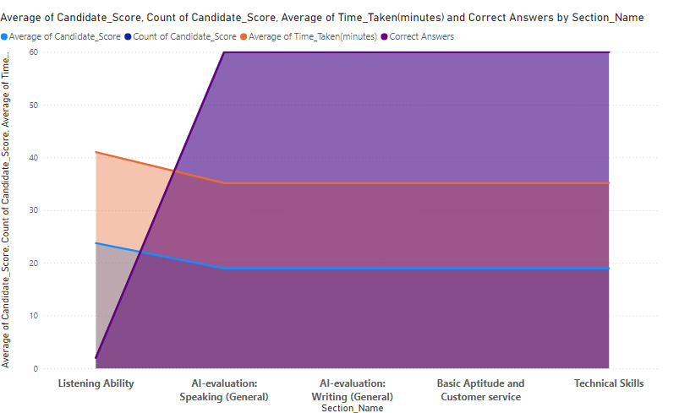
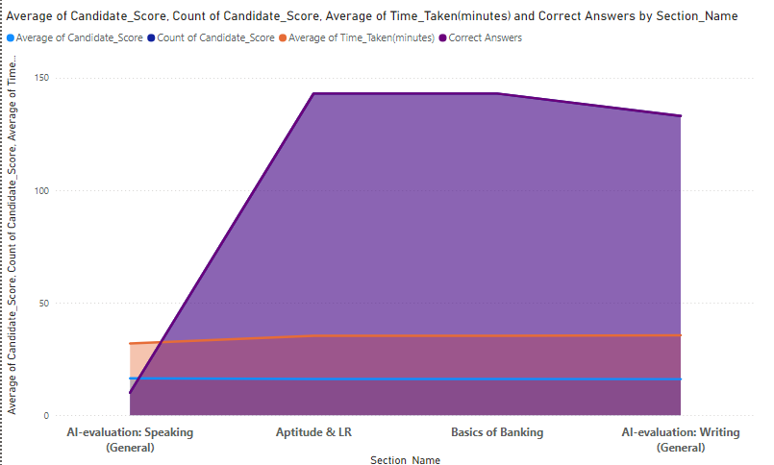
Difficulty Level vs. Scores:

Slide 6
Difficulty Level vs. Scores:
Based upon analysis we can see that the sections AI evaluating Speaking and Listening Ability has higher rate of difficulty.
Candidates are struggling here to clear out section.
This concluded by comparing time taken, score and correctness of answers.
These two sections can be flagged as difficult sections.

Slide 7
Dropout Rate vs. Test Duration
Are longer tests leading to higher dropout rates?
Are there tests with a sudden increase in abandoned attempts?

Slide 8
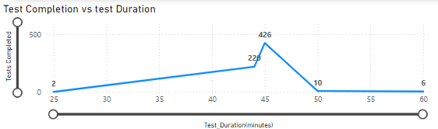
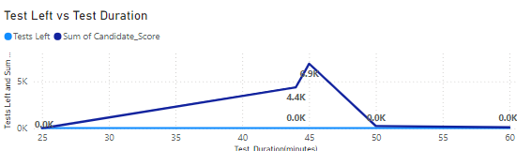
Dropout Rate vs. Test Duration

Slide 9
Dropout Rate vs. Test Duration
We compared completion rate, score and test dropo rate against time.
We found there is no relation between test drop rate and time.
But there is significant relation between test completion rate and time.
The maximum test completion rate observed when average duration of test was 45- 50 min.
This span considered as optimum duration when candidates perform at optimum level.

